Slide 1

INFORMATION ENCODING STANDARDS 02 PROJECT
GROUP 10
INSTRUCTOR: NITAL SHAH
CREATING AN ASP.NET CORE WEB APP WITH USER DATA PROTECTED BY AUTHORIZATION

Slide 2

PROJECT SUMMARY
User Authentication: Users can sign up using their email and password, and their credentials will be securely stored and verified during login.
Role-Based Authorization: Admin users will have access to administrative features, while regular users will have limited access.
Data Protection: Sensitive user data will be protected using data protection mechanisms provided by ASP.NET Core.
The objective of this project is to create a secure ASP.NET Core web application that effectively protects user data using authorization mechanisms.

Slide 3

BENEFITS
ENHANCED SECURITY
CONTROLLED ACCESS TO SENSITIVE DATA
IMPROVED USER EXPERIENCE

Slide 4





MEET THE TEAM
Lukman Abiola
Parth Kalpesh Dave
ID: 200551473
ID: 200556291
Omar Muktar
Namood Sehar
ID: 200474523
ID: 200474523

Slide 5

DEMONSTRATION
In Part 1 of the demonstration, we will walk you through the initial setup and implementation of user authentication and role-based authorization in our ASP.NET Core web app.

Slide 6
PROJECT SETUP
We will create a new ASP.NET Core web application project in Visual Studio
Set up the necessary dependencies and packages required for user authentication and role-based authorization.
Explain the project structure and the role of important files.

Slide 7
USER AUTHENTICATION
Demonstrate the implementation of user authentication using ASP.NET Core Identity.
Show how users can register, log in, and recover their passwords securely.
Discuss the concept of claims-based authentication.

Slide 8
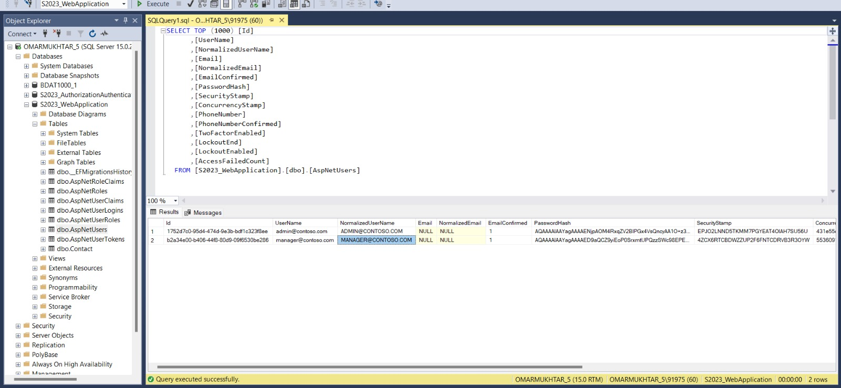
DATA BOX IN SSMS SNAPSHOT OF WHERE BOTH ADMIN AND MANAGER DATA IS SAVED

Slide 9
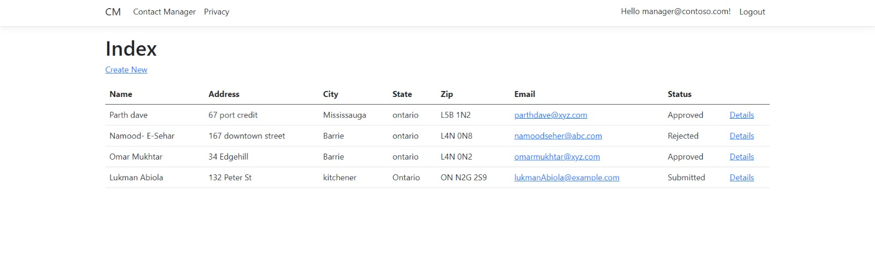
LEVELS OF AUTHORIZATION
Admin has the authority to delete , edit details where else manager has authority to accept or reject the form.

Slide 10
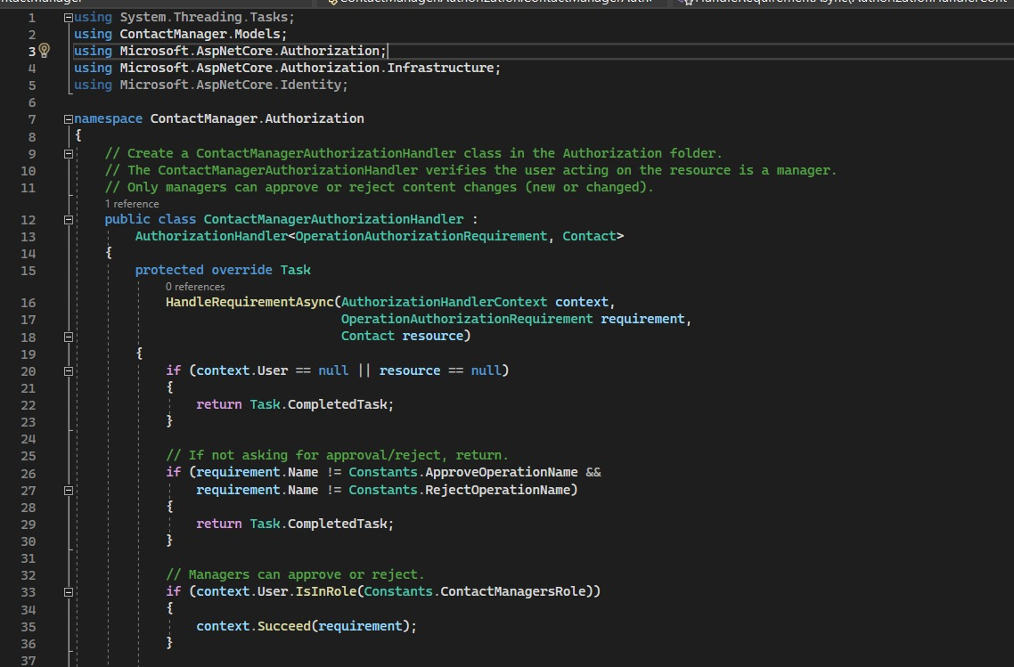
DEFINING AUTHORIZATION
This code defines an authorization handler named ContactManagerAuthorizationHandler for an ASP.NET Core application. It checks if the authenticated user is in the role of "ContactManagersRole." If the user is a manager, they are granted permission to approve or reject content changes (new or changed) on a Contact resource. Otherwise, the authorization fails, and they won't have permission to perform the approval or rejection operation.

Slide 11
ROLE BASED AUTHORIZATION
Set up
Set up role-based authorization to restrict access to certain parts of the web app based on user roles.
Create
Create different roles, such as "Admin" and "User," and associate them with specific functionalities.
Explain
Explain the process of protecting specific routes and actions based on user roles.

Slide 12
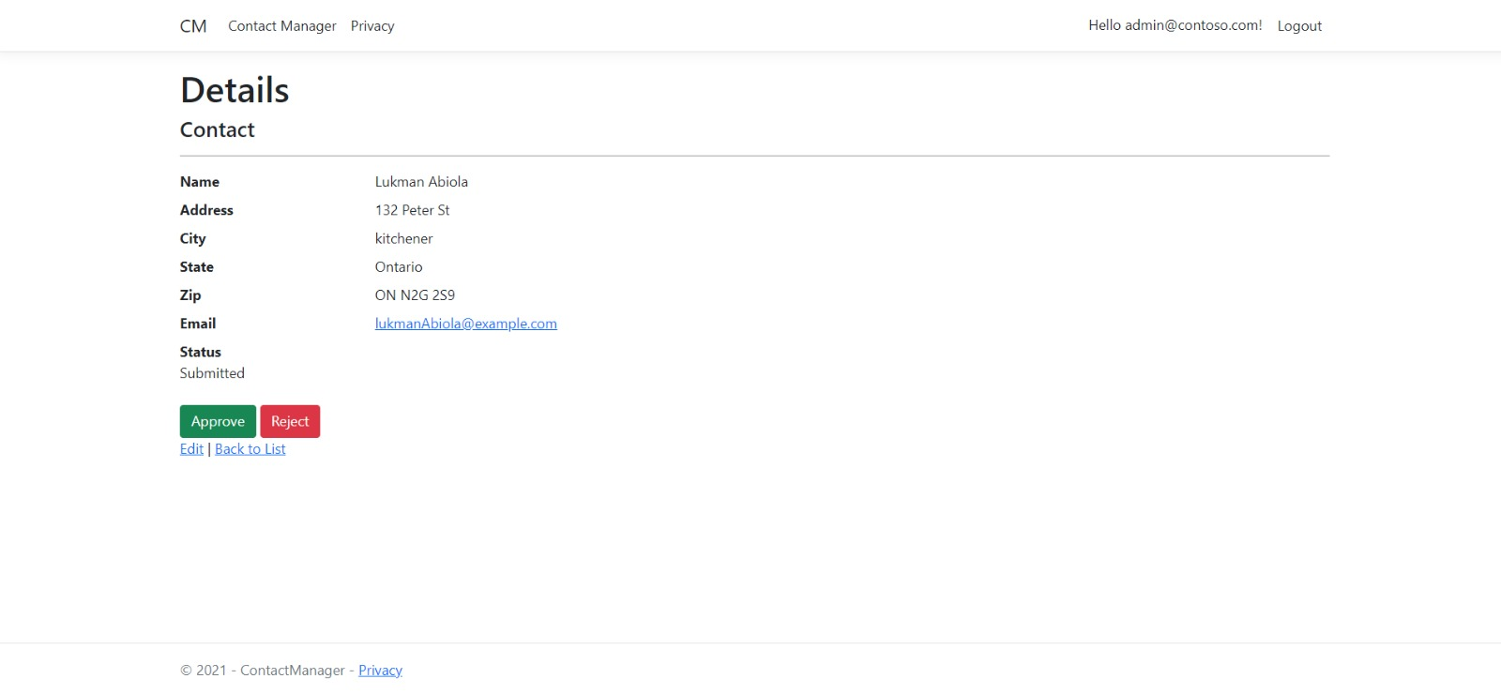
DATA PAGE FOR ADMIN TO APPROVE USER ACCESS

Slide 13
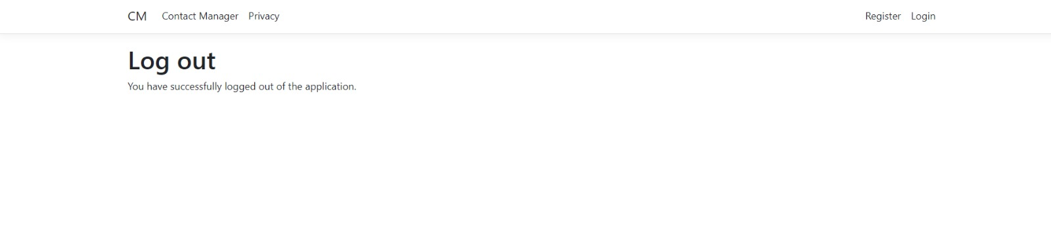
END OF SESSION

Slide 14
CONCLUSION
Throughout this presentation, we have demonstrated the process of creating an ASP.NET Core web app with robust user data protection mechanisms.
We covered the implementation of user authentication, role-based authorization, and data protection to ensure a secure environment for our users' sensitive information.
The key points covered in the presentation include:
Setting up the ASP.NET Core web application with Visual Studio.
Implementing user authentication using ASP.NET Core Identity.
Configuring role-based authorization to control access based on user roles.
Demonstrating data protection techniques to safeguard sensitive user data.

Slide 15

THANK YOU

